Slide 1
Difference between Process and Thread
S.N. | Process | Thread
1 | Process is heavy weight or resource intensive. | Thread is light weight, taking lesser resources than a process.
2 | Process switching needs interaction with operating system. | Thread switching does not need to interact with operating system.
3 | In multiple processing environments, each process executes the same code but has its own memory and file resources. | All threads can share same set of open files, child processes.
4 | If one process is blocked, then no other process can execute until the first process is unblocked. | While one thread is blocked and waiting, a second thread in the same task can run.
5 | Multiple processes without using threads use more resources. | Multiple threaded processes use fewer resources.
6 | In multiple processes each process operates independently of the others. | One thread can read, write or change another thread's data.
Source: https://www.tutorialspoint.com/operating_system/os_multi_threading.htm

Slide 2

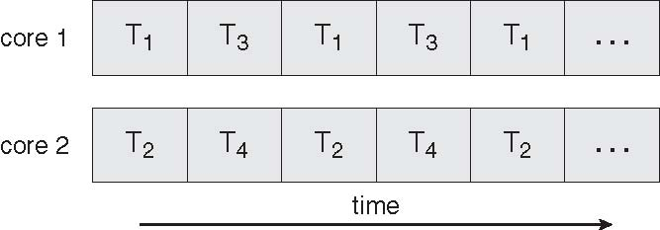
Concurrent Execution on a Single-core System
Serial Execution vs. Parallel Execution
Parallel Execution on a Multicore System

Slide 3
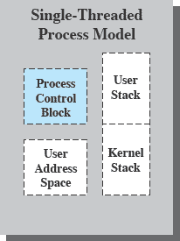
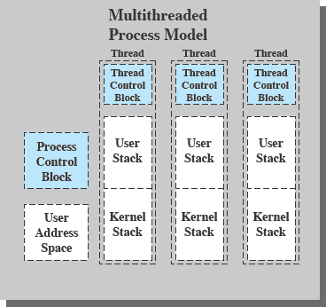
Single & Multithreading Process
Each thread has
An execution state (Running, Ready, etc.)
Saved thread context when not running
An execution stack
Some per-thread static storage for local variables
Access to the memory and resources of its process (all threads of a process share this)
Suspending a process involves suspending all threads of the process
Termination of a process terminates all threads within the process
6
PT / FF 2014

Slide 4

Amdahl’s Law
gives the theoretical speedup in latency of the execution of a task at fixed workload that can be expected of a system whose resources are improved
Where S = portion of program executed serially
N = Processing Cores

Slide 5
Amdahl’s Law Example
we have an application that is 75 percent parallel and 25 percent serial. If we run this application on a system with two processing
cores?
S=25%=0.25, N= 2
If we add two additional cores , calculate speedup?

